Slide 1
“LACK OF WORDS” Vocabulary Lesson
By: Rebecca Shofner

Slide 2
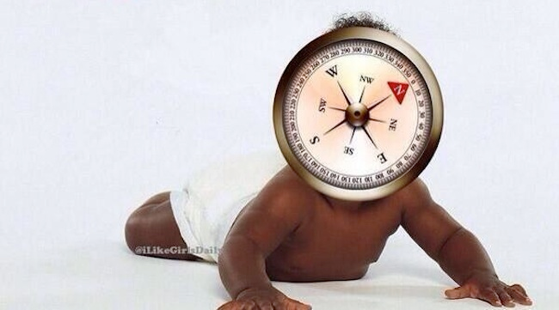
Ambiguous- lacks clarity -I do not understand this. Why would KIM AND KANYE name THEIR child after a cardinal direction? Just wondering……

Slide 3
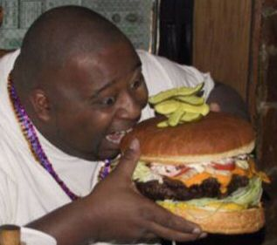
Rash/impulsive-impetuous and therefore lacking in restraint, lacking forethought -the picture says it all.

Slide 4
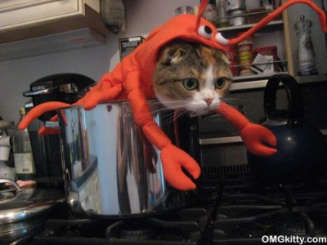
Merciless/ruthless-cruel and therefore lacking in compassion -The person who did this to the poor cat is a great example.

Slide 5
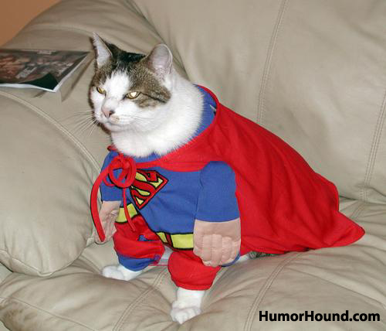
Intrepid/dauntless-brave and therefore lacking fear -that’s a fierce cat.

Slide 6
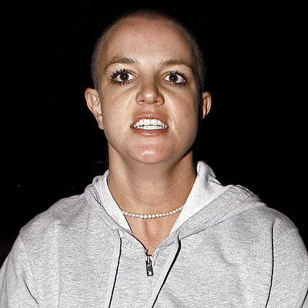
Precarious-lacks stability -poor britney☹

Slide 7
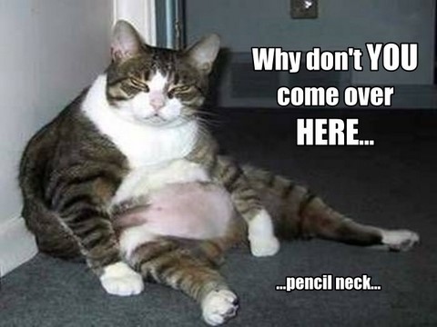
Shiftless-lazy, lackadaisical and therefore lacking ambition

Slide 8
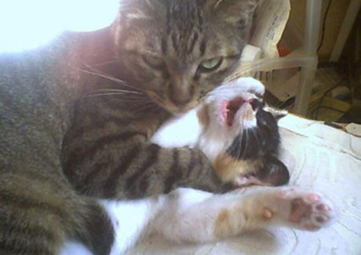
Callous-lacks sensitivity

Slide 9
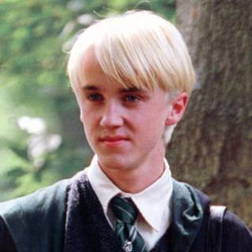
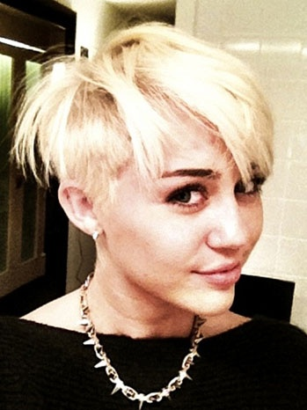
Derivative-derived from and therefore lacking originality - it looks like miley decided to copy draco…..

Slide 10
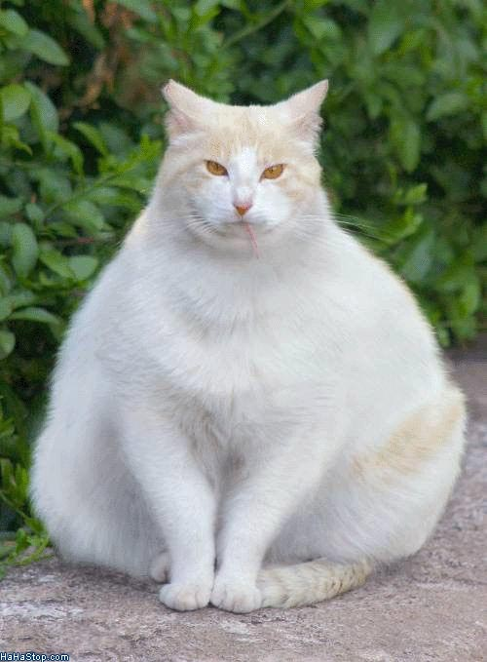
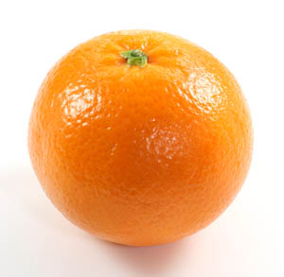
AMORPHOUS- LACKS SHAPE OR FORM -THE CAT AND THE ORANGE DO NOT LACK SHAPE AND FORM. THIS WOULD BE A BAD EXAMPLE OF AMORPHOUS.

